Slide 1

Sanjivani Rural Education Society’s Sanjivani College of Engineering, Kopargaon-423603 (An Autonomous Institute Affiliated to Savitribai Phule Pune University, Pune) NAAC ‘A’ Grade Accredited Department of Computer Engineering (UG program, NBA Accredited)
PROJECT TITLE
SUGARCANE DISEASE INDENTIFICATION USING DEEP LEARNING
Presented By:
Mr. Anas Ansari [UCS20M1011]
Mr. Adarsh Borde [UCS20M1028]
Mr. Pranav Joshi [UCS20M1057]
Ms. Sanskruti Kekan [UCS20F1068]
Guided by:- Dr. P. N. Kalavadekar

Slide 2
Content
Introduction
Scope
Objective
System Architecture
Hardware Description
Software Description
Conclusion

Slide 3
INTRODUCTION
Sugarcane is a major crop cultivated in tropical and subtropical regions, and it is a significant source of sugar and ethanol. However, sugarcane is susceptible to a number of diseases, which can cause significant yield losses.
Detecting these diseases accurately is pivotal in enhancing farmers' crop yields and mitigating disease outbreaks.
Early detection and diagnosis of sugarcane diseases is essential for effective management. Traditional methods of disease identification, such as visual inspection by experts, can be time-consuming and inaccurate.
In many cases, farmers invest resources in disease management without sufficient technical support, resulting in suboptimal disease control. Our project addresses the complex challenge of sugarcane disease detection, which poses significant difficulties for farmers.
Our project seeks to develop a user-friendly, efficient system that leverages technology, specifically Deep Learning, to empower farmers with a more precise and timely disease identification tool.

Slide 4
SCOPE
Image Dataset Collection: Gathering a diverse dataset of sugarcane images containing healthy and diseased samples from various sources.
Deep Learning Model Development: Building and fine-tuning convolutional neural networks (CNNs) or other suitable architectures for disease identification and segmentation.
Real-world Deployment: Considering the feasibility of implementing the system in real-world agricultural settings.
Performance Evaluation: Evaluating the accuracy and efficiency of the model in disease identification and segmentation.

Slide 5
OBJECTIVE
Automated Disease Detection: Develop a deep learning model capable of automatically detecting sugarcane diseases, distinguishing between healthy and infected crops.
Accurate Segmentation: Implement an image segmentation component within the system to precisely outline disease-affected areas on sugarcane leaves.
Multi-Disease Recognition: Enable the model to identify multiple sugarcane diseases, providing a comprehensive solution for farmers.
Scalability: Consider the potential for scalability and adaptation of the system for different regions and disease types to maximize its impact in the agricultural sector.

Slide 6
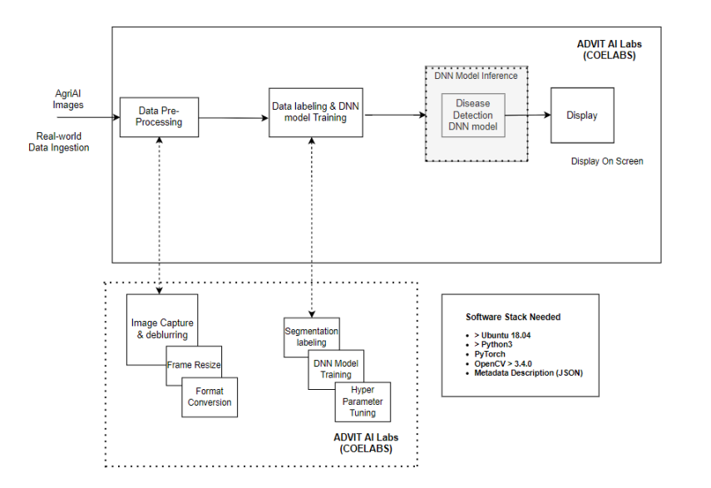
SYSTEM ARCHITECTURE

Slide 7
HARDWARE DESCRIPTION
Laptop
Min. RAM – 8 GB
Nvidia Graphics card (Min. 2 GB)
Ubuntu >=18

Slide 8
SOFTWARE DESCRIPTION
GitHub accounts for repository management
Dockerized models (Basic expertise needed)
OpenCV
Convolutional Neural Networks (CNNs)
a. MaskRCNN
b. U-Net, etc.
c. Tensorflow / PyTorch
d. Python3
https://automatonai.com/advit-ai-labs/
Operating system – windows 7, windows XP, windows 8, windows 10, windows 11, Linux, MacOS
Browser – Any of Mozilla, Chrome
Language – python
Framework- Tensorflow

Slide 9

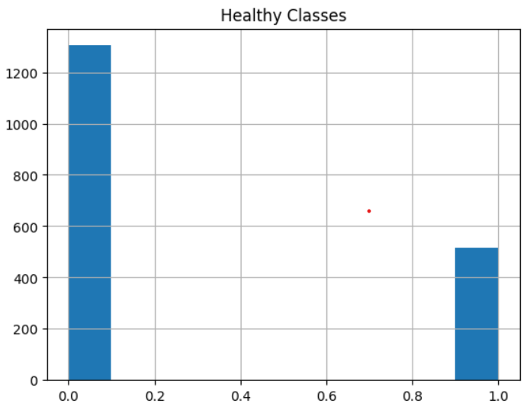
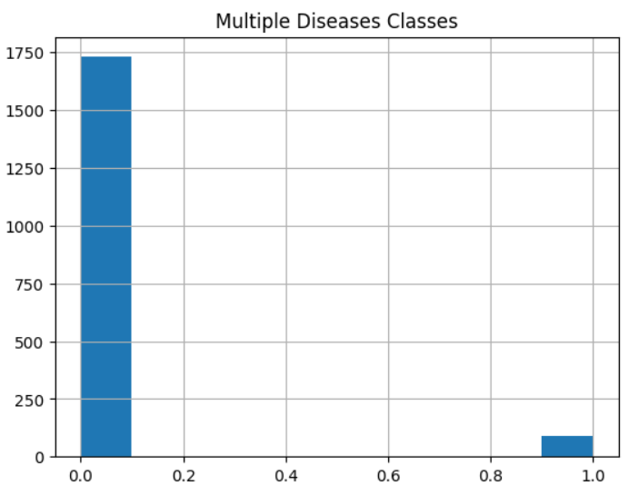
RESULT

Slide 10
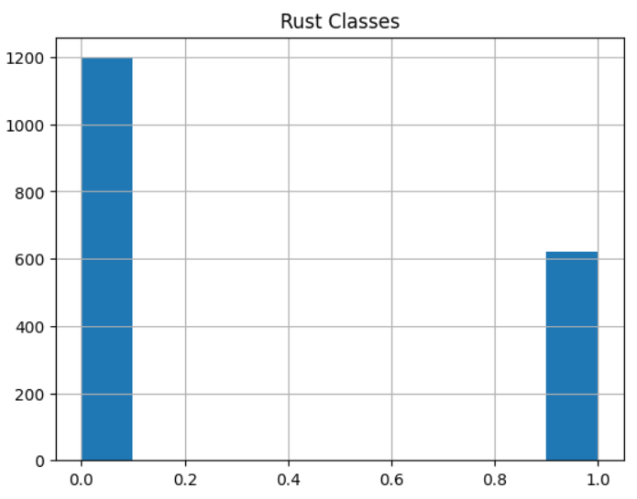
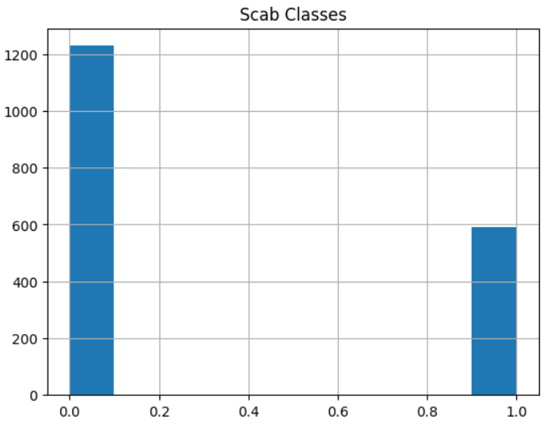
RESULTS

Slide 11

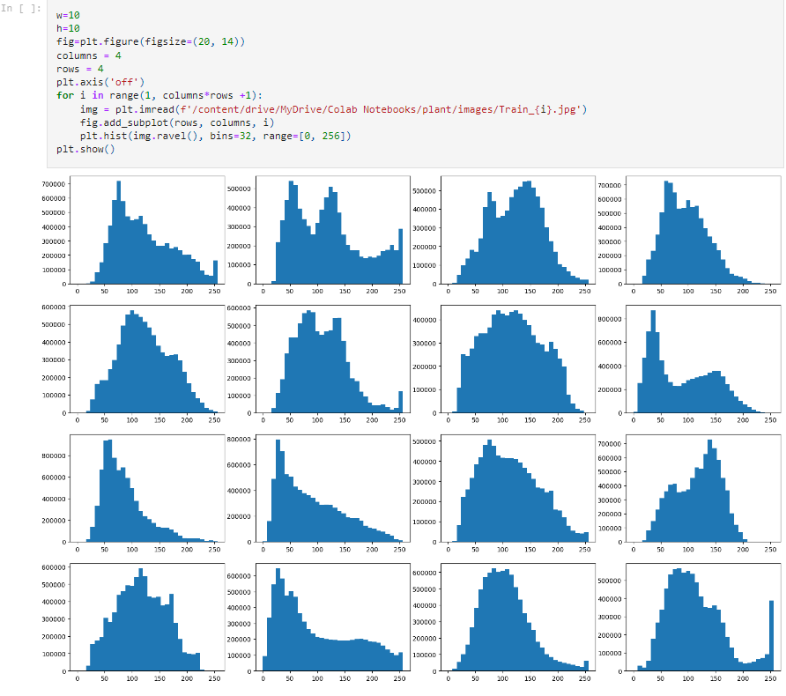
RESULTS

Slide 12
CONCLUSION
In an ever-evolving agricultural landscape, our vision materializes as a beacon of hope for sugarcane farmers. It paints a picture of a future where the arduous battle against sugarcane diseases becomes more manageable.
Harnessing the potential of Deep Learning, this initiative reshapes the dynamics of sugarcane cultivation. It's not merely about detecting diseases; it's a shift towards precision and efficiency, simplifying the process for farmers.
Against the backdrop of climate challenges, fungal threats, and environmental stresses, this initiative assumes the role of a guardian for crop health.
It's a lifeline for farmers, safeguarding their livelihoods and enhancing global food security. Its adaptability ensures accessibility, even in the remotest agricultural regions.

Slide 13
Thank You!!

